Slide 1

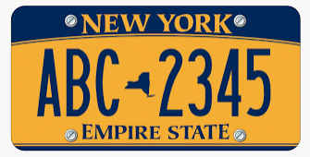
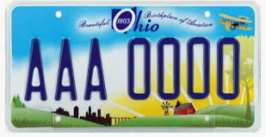
VEHICLE VIOLATION TICKETS IN NYC
By: Arsenio Gonzalez| Branily Banggaroo | Davin Dayle | Shena Khan

Slide 2


AGENDA
Introduction
NYC Vehicle Violations
2019 – 2020 Year to Date (YTD)
NYC Top 5 Violations
NY Licensed Vehicles
Ohio Licensed Vehicles
Total NY Violations for 2019 & 2020
NY Violations for 2019
NY Violations for 2019
NYC Agencies issuing Violations
Top issuing agencies for NY registered licenses
Top issuing agencies for Ohio registered licenses
NYC Top 5 Violations for 2019
Top 5 Violations in NY by Borough
Fine Amount for Top 5 Violations
References

Slide 3
INTRODUCTION
DATA ANALYZED IS FOR NYC VIOLATIONS
PERIOD: 2019 & 2020 (YTD)
https://data.cityofnewyork.us/City-Government/Open-Parking-and-Camera-Violations/nc67-uf89

Slide 4
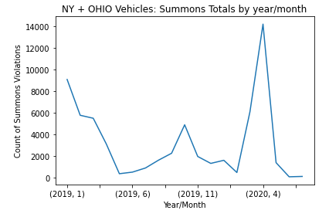
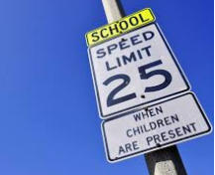
TOTAL NY VIOLATIONS FOR 2019/ 2020

Slide 5
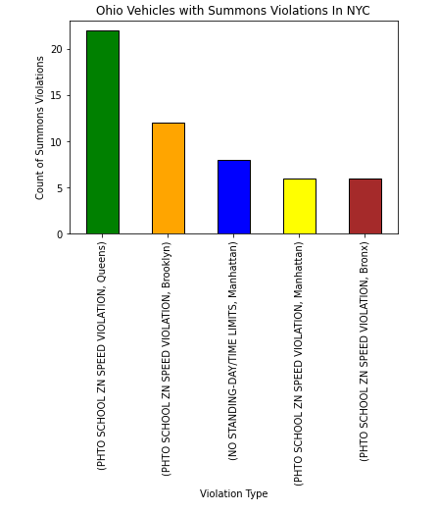
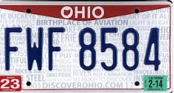
NYC TOP 5 VIOLATIONS Ohio Vehicles

Slide 6
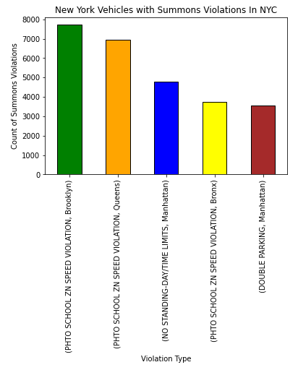
NYC TOP 5 VIOLATIONS NY Vehicles

Slide 7
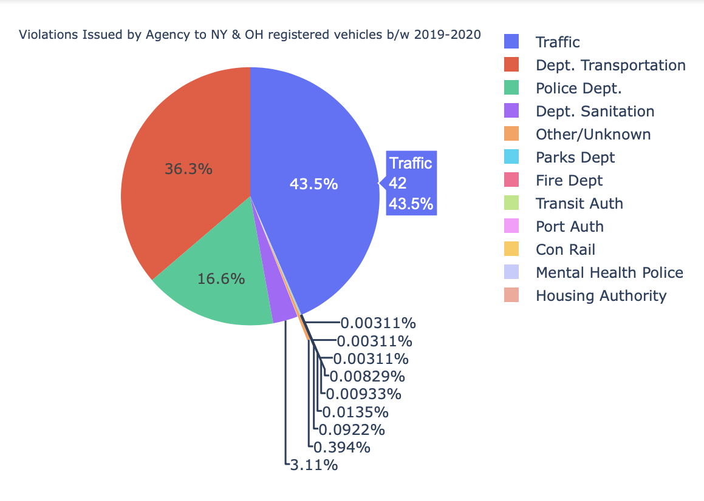
Total Violations Issued by Agency to NY/OH Vehicles

Slide 8
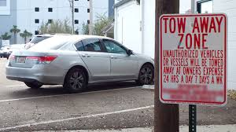
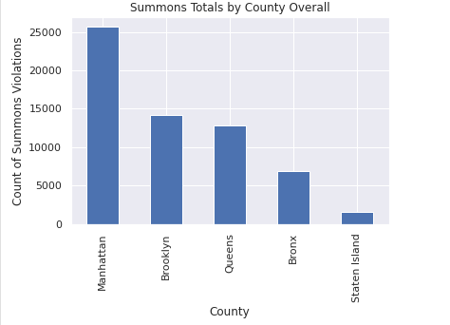
TOTAL NY VIOLATIONS (2019/2020)

Slide 9
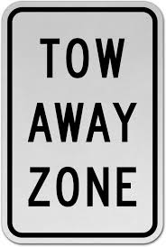
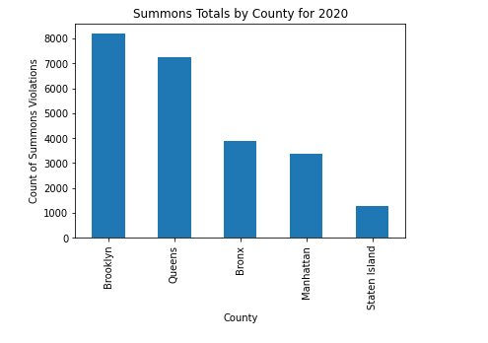
TOTAL NY VIOLATIONS (2020)

Slide 10

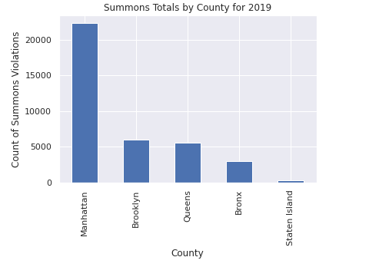
TOTAL NY VIOLATIONS (2019)

Slide 11
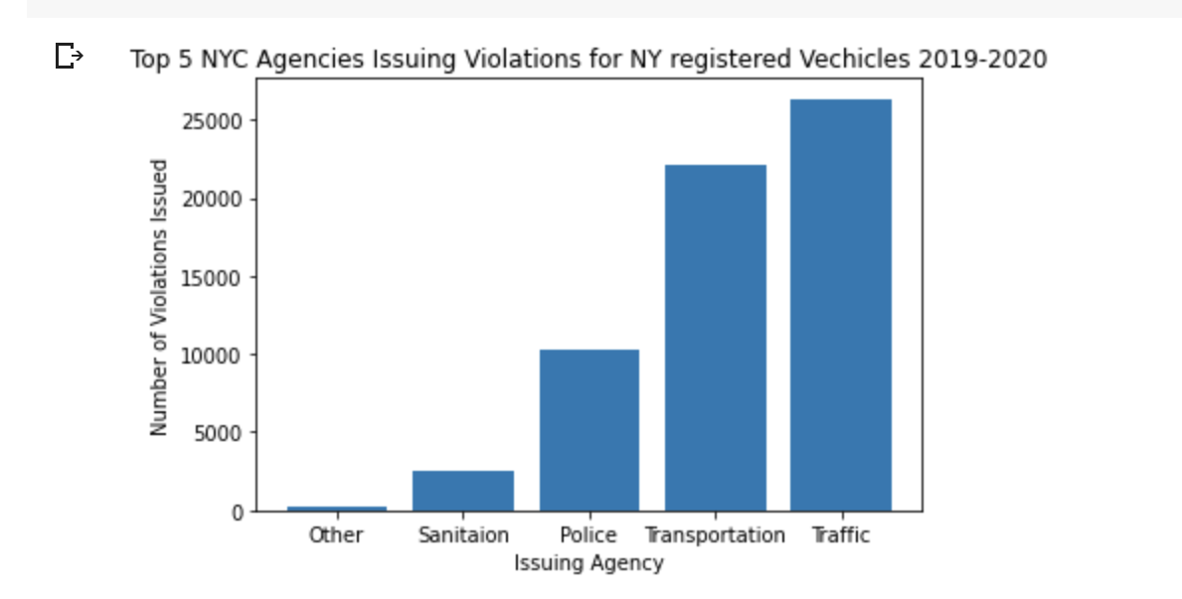
Total Violations Issued to NY registered vehicles by Agency

Slide 12
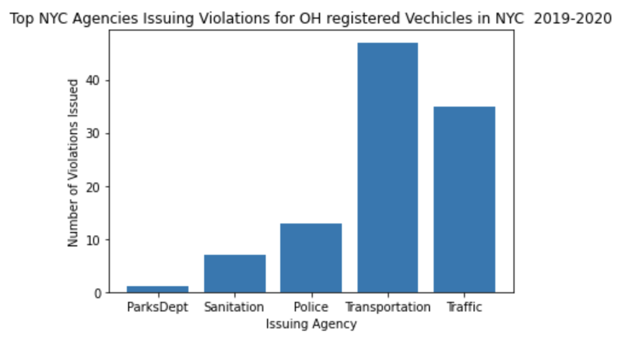
Total Violations Issued to OH registered vehicles by Agency

Slide 13
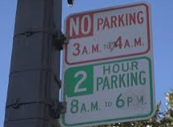
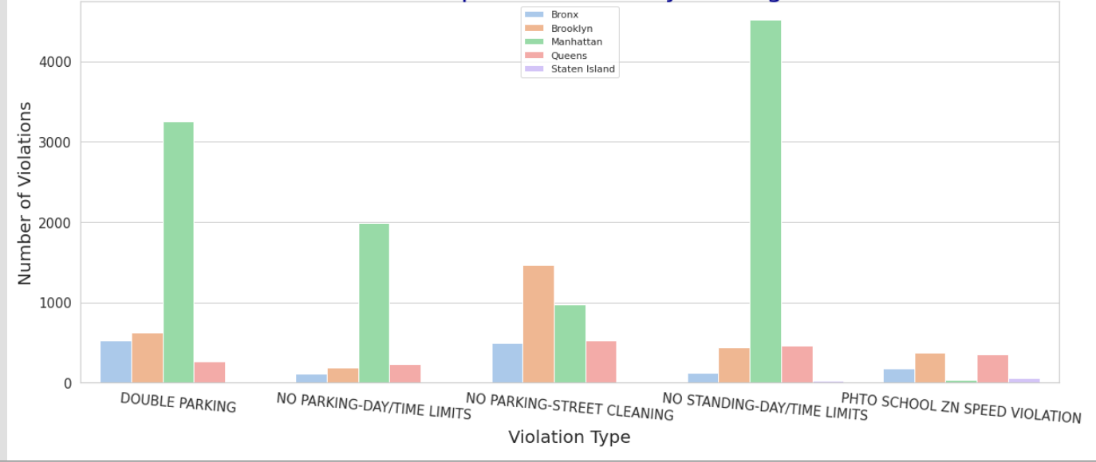
2019 TOP 5 VIOLATIONS IN NY

Slide 14
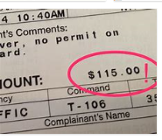
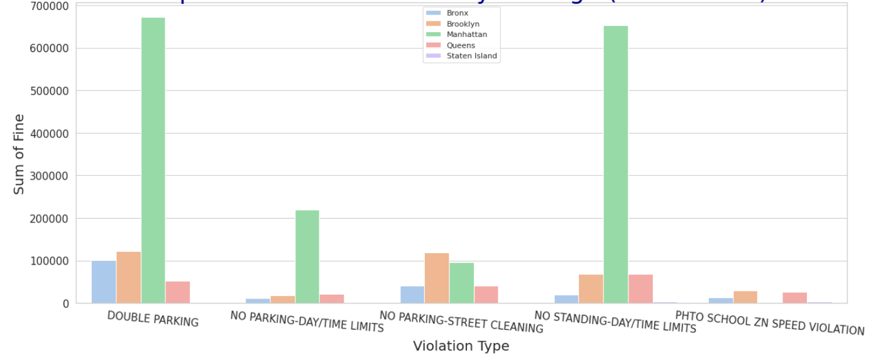
2019 TOP 5 VIOLATIONS FINE BY BOROUGH

Slide 15

References: GitHub Links
https://github.com/zsazsa123/Python-Project3/blob/master/Shena_Project_3.ipynb
https://github.com/dmd2020/Unit-3-Project-3
https://github.com/Branily123/Project-3/blob/master/P3.ipynb
https://github.com/ArsenioMGonzalez3/Project3/blob/master/2020_08_03_Python_Project3_Parking_Cam_Violations.ipynb

